Slide 1
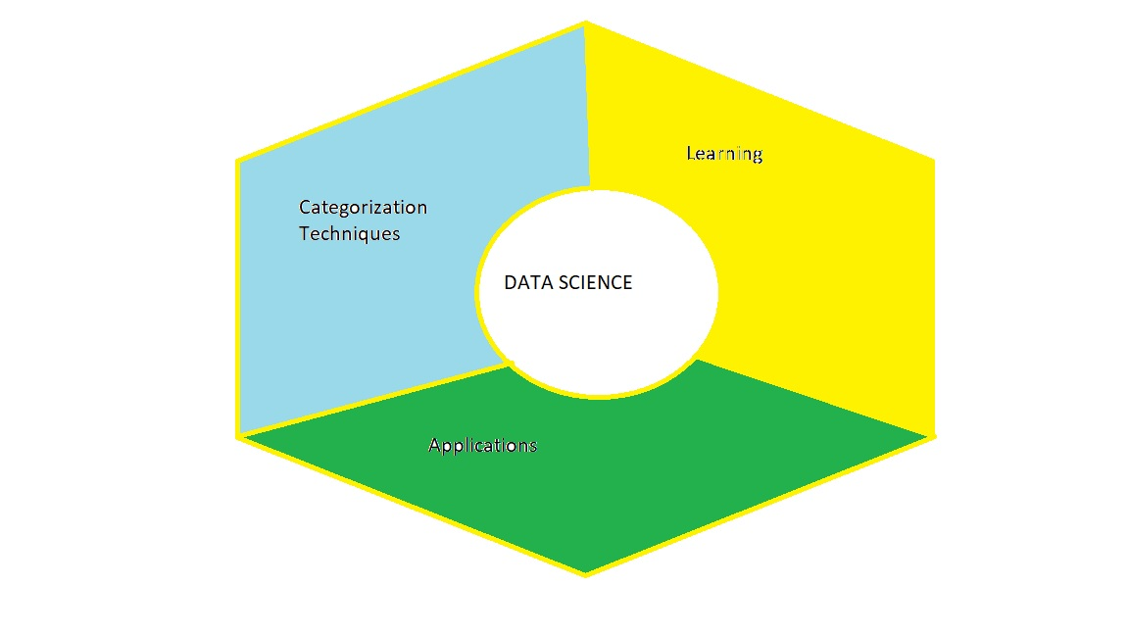
Category ,Learning and Applications in Data Science and Analytics
Vaibhav Chunekar,
Assistant Professor ,
IT Department ,
KJSCE
09 August 2023-Wednesday Venue B302

Slide 2
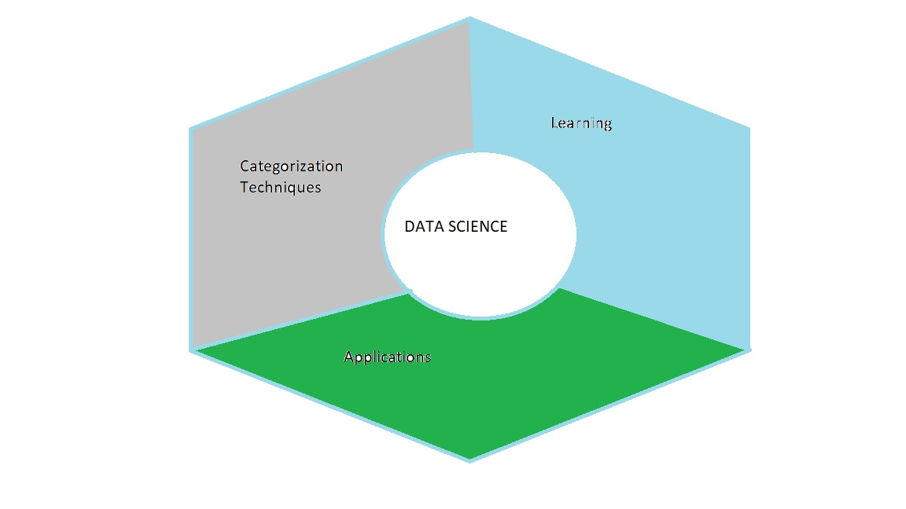
Data Science & Analytics
Categorization Techniques
Descriptive
Prescriptive
Big Data
Anomaly Detection
Classification
Regression
Exploratory…
Learning:
Supervised
Unsupervised
Reinforcement
Semi -supervised
Applications:
Agriculture
Healthcare
Disaster Management…

Slide 3
Categorization of Data Analytics Techniques
1. Descriptive Analytics:
Focus: Summarizing and presenting historical data to provide insights into past trends and events.
Techniques: Aggregation, visualization, basic statistical analysis, dashboards.

Slide 4
Categorization of Data Analytics Techniques
2. Diagnostic Analytics:
Focus: Understanding the reasons behind past events or trends.
Techniques: Root cause analysis, hypothesis testing, anomaly detection.

Slide 5
Categorization of Data Analytics Techniques
3. Exploratory Data Analysis (EDA):
Focus: Exploring data to understand its structure, patterns, and relationships.
Techniques: Data visualization, summary statistics, correlation analysis.

Slide 6
Categorization of Data Analytics Techniques
4. Predictive Analytics:
Focus: Making predictions about future events or outcomes based on historical data and patterns.
Techniques: Regression analysis, time series forecasting, machine learning algorithms.
5. Prescriptive Analytics:
Focus: Providing recommendations or actions to optimize decisions and outcomes.
Techniques: Optimization algorithms, decision trees, simulation models.

Slide 7
Categorization of Data Analytics Techniques
6.Text Analytics (Natural Language Processing - NLP):
Focus: Analyzing and extracting insights from text data.
Techniques: Sentiment analysis, topic modeling, text classification.
7.Image and Video Analytics:
Focus: Analyzing visual data such as images and videos.
Techniques: Object detection, image segmentation, facial recognition.

Slide 8
Categorization of Data Analytics Techniques
8. Spatial Analytics (Geospatial Analytics):
Focus: Analyzing data with geographic or spatial components.
Techniques: Geographic Information Systems (GIS), spatial clustering, mapping.
9. Time Series Analysis:
Focus: Analyzing data collected over time to identify patterns and trends.
Techniques: Time series decomposition, autocorrelation, seasonality analysis.

Slide 9
Categorization of Data Analytics Techniques
10. Social Network Analysis:
Focus: Analyzing relationships and interactions within social networks.
Techniques: Network metrics, community detection, influence analysis.
11. Cluster Analysis:
Focus: Grouping similar data points into clusters or segments.
Techniques: K-means clustering, hierarchical clustering, DBSCAN.

Slide 10
Categorization of Data Analytics Techniques
11. Association Rule Mining:
Focus: Identifying relationships and patterns between variables in large datasets.
Techniques: Apriori algorithm, frequent itemset mining.
12. Big Data Analytics:
Focus: Processing and analyzing massive volumes of data that traditional methods cannot handle.
Techniques: Distributed computing, Hadoop, Spark.

Slide 11
Categorization of Data Analytics Techniques
13. Classification and Regression:
Focus: Predicting categorical (classification) or continuous (regression) outcomes.
Techniques: Decision trees, logistic regression, support vector machines.
14 Anomaly Detection:
Focus: Identifying unusual or rare data points that deviate from the norm.
Techniques: Statistical methods, machine learning algorithms.

Slide 12
Learning in Data Science

Slide 13
Learning in AI
Learning, in a general sense, refers to the acquisition of knowledge, skills, or understanding through study, experience, or teaching. It is a fundamental process that enables individuals, animals, and machines to adapt, improve, and make better decisions based on past experiences and information.
AI-artificial intelligence (AI) that focuses on the development of algorithms and models that enable machines or computer systems to learn from data.
Machine learning algorithms improve their performance on a specific task without being explicitly programmed.

Slide 14
Learning Model
The learning model is the core component of a machine learning system that enables it to make predictions or decisions based on input data.
It is trained on a labeled dataset during the learning phase, where the model adjusts its internal parameters or structure to learn patterns and associations between input features and output labels

Slide 15
Effects of Learning
Once the learning model is trained, it can be used to:
make predictions on new, unseen data,
providing valuable insights,
classifications, or
regression predictions.
The performance and accuracy of the learning model depend on how well it generalizes to new data and how effectively it captures the underlying patterns in the training data.

Slide 16
Types of Learning in Data Science
Supervised
Unsupervised Learning
Reinforcement Learning

Slide 17
Supervised learning algorithms
Linear Regression
Decision Trees
Random Forests
Support Vector Machines (SVM)
Neural Networks.

Slide 18
Examples - Supervised Learning
Email spam classification (binary classification)
Handwritten digit recognition (multiclass classification)
House price prediction (regression).

Slide 19
Main Steps in Supervised Learning
a. Data Collection: Gather a dataset containing input features and their corresponding output labels (target).
b. Data Preprocessing: Clean, normalize, and transform the data to make it suitable for the learning algorithm.
c. Model Training: Use the labeled training data to train the machine learning model, which aims to find patterns and relationships between the input features and the target output.
d. Model Evaluation: Assess the performance of the model on a separate validation or test dataset to measure how well it generalizes to new data.
e. Model Deployment: Once the model has been trained and evaluated, it can be deployed to make predictions on new, unseen data.

Slide 20
Unsupervised Learning
It deals with data that is not labeled or does not have a known output.
Goal : To find patterns or relationships within the data
without explicit guidance on the target variable.

Slide 21
Steps Unsupervised Learning
a. Data Collection: Gather a dataset containing only input features, without any corresponding output labels.
b. Data Preprocessing: Clean, normalize, and transform the data as needed.
c. Model Training: Use the unsupervised learning algorithm to identify patterns, clusters, or structure within the data.
d. Model Evaluation: Unlike supervised learning, unsupervised learning does not have a specific evaluation metric since there are no ground truth labels.
Evaluation is often subjective and domain-specific.

Slide 22
Unsupervised learning -Algorithms
K-Means Clustering
Hierarchical Clustering
Principal Component Analysis (PCA)
Autoencoders.

Slide 23
Examples Unsupervised Learning
Customer segmentation
Anomaly detection
Topic Modeling.

Slide 24
Reinforcement Learning
It is a type of learning in which an agent interacts with an environment and learns to make decisions to maximize some notion of cumulative reward.
The agent takes actions in the environment and receives feedback in the form of rewards or penalties, guiding it to improve its decision-making over time.
Reinforcement learning is commonly used in tasks like robotics, game playing, and optimization problems.

Slide 25
RL Algorithm
RL algorithms aim to find the optimal policy that maximizes the expected cumulative reward over time.
These algorithms can be model-free or model-based.
Model-free RL methods directly learn the policy or value function from experiences, while model-based RL methods learn a model of the environment and then use it for decision-making.

Slide 26
Key components - Reinforcement Learning:
Agent: The learner or decision-maker that interacts with the environment.
Environment: The external system with which the agent interacts. The environment is dynamic and responds to the agent's actions by transitioning to new states and providing rewards or penalties.
State: A representation of the environment at a specific time point, describing the current situation.
Action: The set of possible moves or decisions that the agent can make to influence the environment.

Slide 27
Key components - Reinforcement Learning:
Reward: A numerical value that the environment provides to the agent as feedback after each action. The reward indicates how good or bad the action was in achieving the agent's objective.
Policy: A strategy or set of rules that the agent follows to determine its actions based on the current state. The policy maps states to actions.
Value Function: A function that estimates the expected cumulative reward from a given state under a specific policy. It guides the agent to choose actions that lead to higher expected rewards.
Q-Function (Action-Value Function): A function that estimates the expected cumulative reward when taking a specific action in a given state and following a specific policy.

Slide 28
Applications of Reinforcement Learning
Game playing: RL has achieved remarkable success in playing complex games like chess, Go, and video games.
Robotics: RL is used to train robots to perform various tasks in real-world environments.
Autonomous vehicles: RL is applied to train self-driving cars to make decisions on the road.
Recommendation systems: RL can be used to optimize the recommendations made to users.
Resource management and optimization: RL is used in optimizing energy consumption, traffic flow, and other resource allocation problems.

Slide 29
Summary Reinforcement Learning
Reinforcement Learning is a powerful paradigm for solving sequential decision-making problems where the agent's actions impact future outcomes and rewards, making it a fundamental approach in areas involving decision-making under uncertainty.

Slide 30
Semi supervised Learning
It's important to note that there is also a another category called semi-supervised learning, which is a combination of supervised and unsupervised learning.
Semi-supervised learning uses a small amount of labeled data along with a large amount of unlabeled data to improve the model's performance and generalization

Slide 31
Key Features of Semi-Supervised Learning
SSL is useful when obtaining labeled data is expensive or time-consuming, as it can utilize a larger pool of unlabeled data.
The main assumption in SSL is that the structure of the data learned from the unlabeled samples can help in generalizing better to the labeled samples.
SSL is commonly used in scenarios where labeled data is limited, such as in natural language processing, image classification, and data clustering.

Slide 32
Difference between Reinforcement learning and Semi supervised Learning
Reinforcement learning is focused on learning from rewards and penalties in sequential decision-making problems
while semi-supervised learning aims to use unlabeled data to enhance the performance of models in situations where labeled data is limited or expensive to obtain

Slide 33
Applications of Data science in real world

Slide 34
Medical and Healthcare
Diagnosis and Prediction: Data science is used to develop predictive models for diagnosing diseases based on medical records, lab results, and patient history.
Drug Discovery: Data analysis helps in identifying potential drug candidates by analyzing molecular structures and their interactions.

Slide 35
Medical and Healthcare
Personalized Treatment: Data-driven approaches help in tailoring treatment plans for individual patients based on their genetic makeup and medical history.
Health Monitoring: Wearable devices and sensors collect data for real-time health monitoring, enabling early detection of anomalies.
Epidemiology and Public Health: Data analysis assists in tracking disease outbreaks, identifying risk factors, and planning public health interventions

Slide 36
Agriculture
Precision Agriculture:
Data-driven insights optimize crop planting, irrigation, and pesticide application, enhancing yield and resource efficiency.
Crop Disease Detection:
Image processing and data analytics help in early identification of crop diseases through visual symptoms.

Slide 37
Agriculture
Supply Chain Optimization:
Data science optimizes logistics, storage, and distribution of agricultural products.
Climate and Weather Analysis:
Analyzing historical data helps farmers make informed decisions based on weather patterns based on behavior and preferences.

Slide 38
Disaster Management
Early Warning Systems:
Data science models predict natural disasters like hurricanes, earthquakes, and floods, enabling early evacuation and preparedness.
helping authorities respond effectively.

Slide 39
Disaster Management
Resource Allocation: During and after disasters, data analytics aids in distributing resources efficiently, such as medical supplies and rescue teams.
Sentiment Analysis: Social media data is analyzed to understand public sentiment during disasters

Slide 40
Finance and Banking
Risk Assessment: Data science models evaluate credit risk, fraud detection, and market volatility.
Algorithmic Trading: Complex algorithms analyze financial data to make automated trading decisions.
Customer Segmentation: Data-driven insights help create personalized marketing strategies and product recommendations.
Fraud Detection: Anomaly detection algorithms identify unusual patterns in transactions to flag potential fraud.

Slide 41
Retail and E-commerce
Recommendation Systems: Data science powers personalized recommendations for products and services.
Demand Forecasting: Analyzing historical data helps in predicting product demand, optimizing inventory management.
Price Optimization: Algorithms analyze market trends and competitors to set optimal pricing.
Customer Segmentation: Data-driven insights group customers based on behavior and preferences.

